Slide 1

Health Information System
for managing clients and health programs.

Slide 2
Key Features
Secure Authentication
Role-based access for doctors.
Program Management
Create/enroll clients in TB, HIV, Malaria programs.
Client Profiles
Search, view, and edit client details.
API-First Design
JSON endpoints for integration (e.g., mobile apps).

Slide 3
Technology Stack
Backend: Laravel 11 (MVC architecture)
Database: SQLite (lightweight, file-based)
Auth: Laravel Sanctum (API token security)
Frontend: Blade + Livewire (dynamic UI)
Security: CSRF tokens, hashed passwords

Slide 4

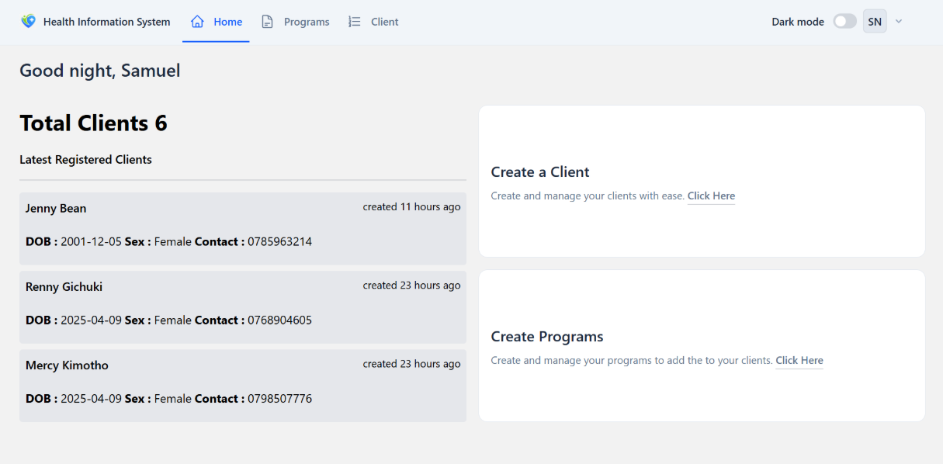
Screenshots
Login/Register
Secure doctor authentication.
Client Dashboard
List view with search functionality.
Program Enrollment
Assign clients to health programs.
API Demo
Fetch client data via authenticated requests.

Slide 5
Database Design
Relationships:
User → Has many Clients
Client → Belongs to many Programs (via client_programs pivot)
Program → Managed by User (doctor)
Visual flow of models (User → Client ↔ Program).

Slide 6
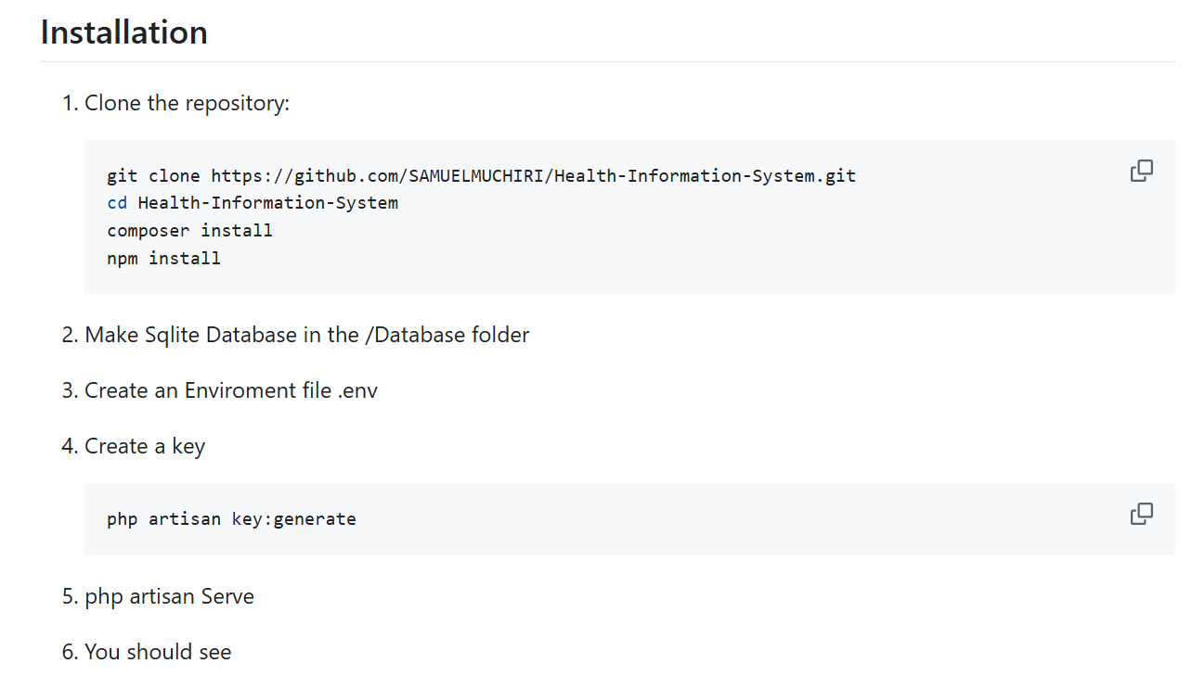
Getting Started

